Slide 1
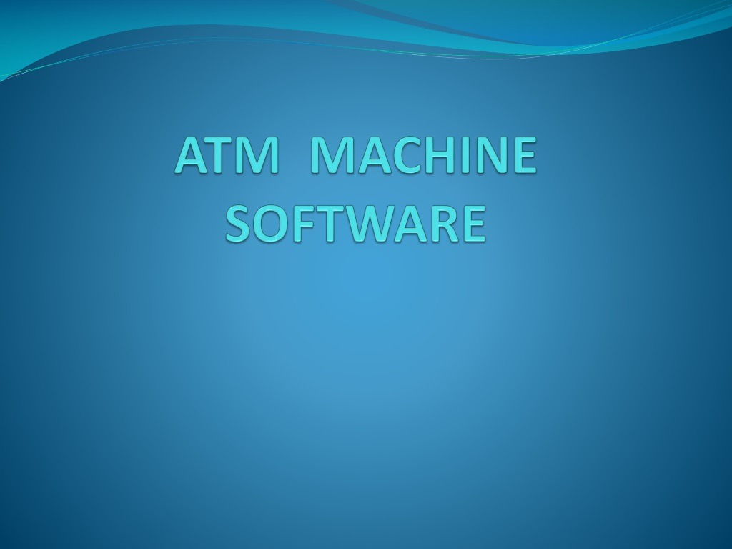

Slide 2
INTRODUCTION
• An Automated Teller Machine (ATM) allows customers to perform banking transactions anywhere
and at anytime without the need of human teller.
• By using a debit or ATM card at an ATM, individuals
can withdraw cash from checking or savings accounts,
make a deposit or transfer money from one account to
another or perform other functions.
• You can also get cash advances using a credit card at an ATM.

Slide 3
PROCESS OF ATM TRANSACTION
• . First, the client will insert his/her client card in the
ATM and then the ATM will ask for a Personal
Identification Number (PIN) ,
• if the number is entered incorrectly several times in a
row, most ATMs will retain the card as a security
precaution to prevent an unauthorised user from
working out the PIN by pure guesswork.
• Once the correct PIN is given, the ATM will ask for the amount of money to be withdrawn.

Slide 4
Continued ....
• If the amount is available and if the client has enough
money on his credit then the said amount of money will be
paid.
• Whether the amount of money is payable or not, i.e. the
ATM has enough cash but could be the case the ATM has
no change for that amount, will be also checked.
• Once the money is offered to the client a countdown is
started, i.e. the client has a determined amount of time to
pick up the money.
• If this timeout is over, the money will be collected by the
ATM and the transaction will be rolled.

Slide 5
HARDWARE REQUIREMENT
• The Ram memory requirement is 256 MB (Minimum)
/ 512 MB (Recommendable)
• The Hard Disk free space requirement is 200 MB
• Pentium 4 processor IGhz.

Slide 6
SOFTWARE REQUIREMENT
• The Operating System on which this software can run
easily, Windows XP/Vista/7
•JDBC connection
ECLIPSE
MYSQL

Slide 7
NEED OF PROJECT
• An automatic teller machine increases existing business.
The typical ATM customer will spend 20-25% more than a
non-ATM customer, according to research conducted by
AT&T Global Information Solutions.
• An automatic teller machine generates new business.
Customers are more likely to seek out a location with an
automatic teller machine, in addition to convenience, there
are a number of safety benefits associated with an in-store
automatic teller machine, according to survey results
published in Petroleum Marketer magazine.

Slide 8
• An automatic teller machine provides additional
revenue streams. Each ATM withdrawal transaction
generates surcharge ("convenience fee") income for the
owner of the automatic teller machine.
• Additionally, an automatic teller machine can provide
revenue from on-screen advertising, couponing, and
alternative media (e.g., prepaid phone-cards, postage
stamps) dispensing opportunities.

Slide 9
• An automatic teller machine reduces risk and lowers
costs. Having an automatic teller machine on the
premises can reduce the number of bad checks and cut
credit card expenses because customers have the
option of withdrawing cash instead.
• An automatic teller machine pays for itself. With
break-even points below 100 transactions per month,
even a low traffic location can more than pay for an
automatic teller machine from surcharge revenues
alone

Slide 10
THANK YOU

